Slide 1


Confusion Matrix
Machine Learning
… isn’t so confusing, if you understand what it really is!

Slide 2
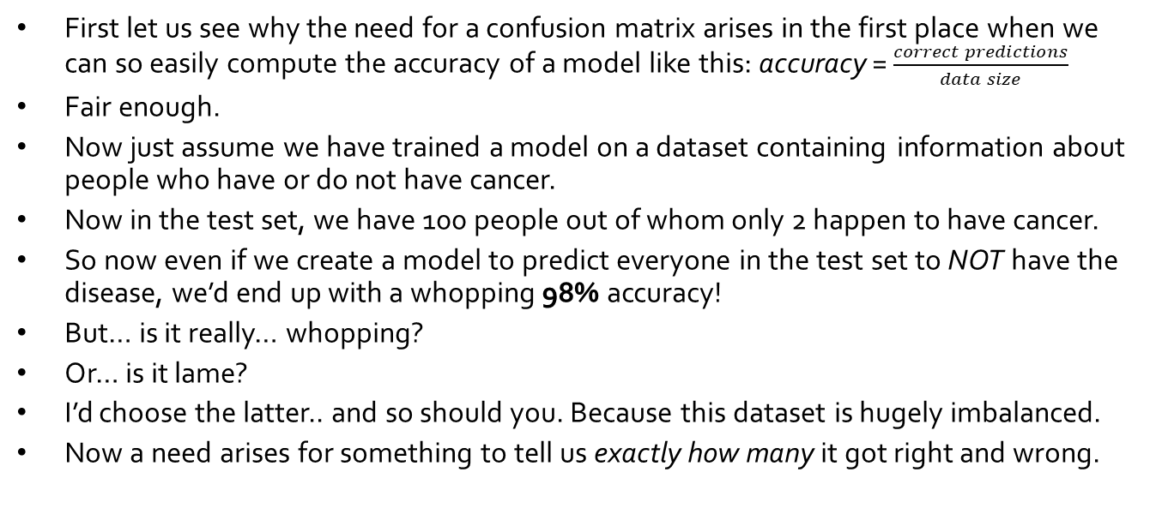
Why confusion matrix?
First let us see why the need for a confusion matrix arises in the first place when we can so easily compute the accuracy of a model like this: accuracy = $\frac{correct predictions}{data size}$
Fair enough.
Now just assume we have trained a model on a dataset containing information about people who have or do not have cancer.
Now in the test set, we have 100 people out of whom only 2 happen to have cancer.
So now even if we create a model to predict everyone in the test set to NOT have the disease, we’d end up with a whopping 98% accuracy!
But… is it really… whopping?
Or… is it lame?
I’d choose the latter.. and so should you. Because this dataset is hugely imbalanced.
Now a need arises for something to tell us exactly how many it got right and wrong.

Slide 3
Confusion matrix
It is an n x n matrix, where n = number of different classes (for binary, n=2)
Used for classification tasks.
In a clear and concise manner, provides us a table clearly indicating how many labels were correctly classified and how many weren’t.
The name stems from the fact that we are trying to calculate the number of instances where the classifier was ”confused” in predicting the correct labels.
Used in making the ROC curves and calculating the Area Under the Curve (AUC) for discriminating between a good model and an average model.

Slide 4
Confusion matrix

Slide 5
TP True Positive (say it as : Truly positive) When we predict the class to be positive, and when it actually is positive --> “We correctly predicted the data point as positive”
TN True Negative (say it as : Truly negative) When we predict the class to be negative, and when it actually is negative --> “We correctly predicted the data point as negative”
FP False Positive (say it as Falsely positive) (Type I error) When we predict the class to be positive, but it actually belongs to the negative class --> “We falsely predicted the data point as positive”
FN False Negative (say it as Falsely negative) (Type II error) When we predict the class to be negative, but it actually belongs to the positive class --> “We falsely predicted the data point as negative”

Slide 6

False Positive (Type I error)
False Negative (Type II error)
One easy way to remember type 1 and Type 2 error is to use the Roman format
We make a slant line between the two I I to think of it as “N”
Hence, we now know that Type 2 or Type II error is False “N”egative

Slide 7
That would be all for this one
In the next one we’ll talk about the various metrics like Precision, Recall,
Sensitivity, Specificity,
F1 score, F-beta score
and easy ways to remember their definitions and formulae
Hope to see you there! :)

